Slide 1

Hardware Implementation of Addition and Subtraction
Computer Organization and Architecture | Computer Arithmetic
Course: Computer Organization and Architecture | Chapter: Computer Arithmetic | Program: Bachelor of Engineering
DISCOVER · LEARN · EMPOWER
Notes:
Welcome everyone to today's lecture on Computer Arithmetic. We will focus specifically on how hardware performs the most fundamental operations: addition and subtraction. These operations form the backbone of all arithmetic logic units in modern processors. Let us begin by understanding the learning outcomes for this session.

Slide 2
Course Outcomes
SLIDE 2 / 10
Course Outcome
CO | BT LEVEL | DESCRIPTION
CO1 | BT3 | Apply number systems and digital logic to design basic digital circuits
CO2 | BT4 | Analyze register organization and instruction set architecture
CO3 | BT3 | Implement computer arithmetic algorithms and floating-point operations
CO4 | BT5 | Analyze memory hierarchy and input-output organization
CO5 | BT6 | Evaluate control unit design and pipelining performance
Chandigarh University
2 / 10
Notes:
Today's lecture directly addresses Course Outcome 3, which requires you to implement computer arithmetic algorithms. We will see how these algorithms translate into physical hardware circuits. By the end of this session, you will understand the logic behind adding and subtracting binary numbers. This is essential for designing efficient arithmetic logic units.

Slide 3
Learning Objectives
SLIDE 3 / 10
Learning Outcomes
1
Analyze the operation of half and full adder circuits for binary addition.
2
Construct ripple carry adders to handle multi-bit binary number addition.
3
Explain the two's complement method for hardware subtraction implementation.
4
Evaluate the propagation delay issues in serial adder designs.
5
Differentiate between unsigned and signed number handling in arithmetic circuits.
Chandigarh University
3 / 10
Notes:
By the end of this lecture, you will be able to analyze how half and full adders work at the gate level. You will learn to construct ripple carry adders for larger numbers and understand the critical role of two's complement in subtraction. We will also evaluate the speed limitations of serial adders compared to parallel designs.

Slide 4
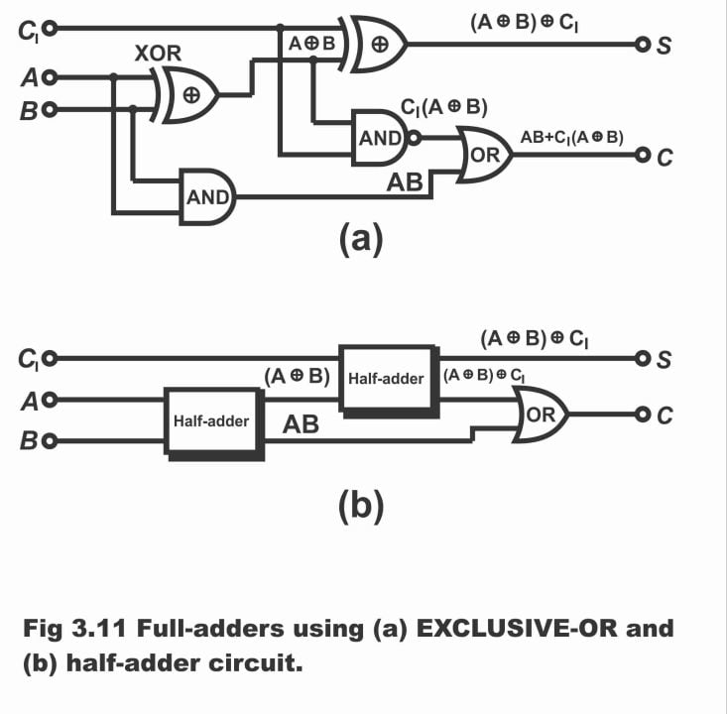
Lecture
SLIDE 4 / 10
Half Adder and Full Adder Basics
GOVERNING EQUATION
The sum equation is S = A XOR B XOR C_in for three inputs
1
A half adder adds two single bits and produces a sum and carry output.
2
The sum output is the XOR of the two input bits A and B.
3
The carry output is the AND of the two input bits A and B.
4
A full adder adds three bits: two operands and a carry-in from previous stage.
5
The carry-out equation is C_out = (A AND B) OR (C_in AND (A XOR B)).
Half adder and Full adder with Equation in Digital Electronics
Chandigarh University
4 / 10
Notes:
Let's start with the building blocks. A half adder handles two bits, giving us a sum and a carry. For example, adding 1 and 1 gives a sum of 0 and a carry of 1. A full adder is more powerful as it includes a carry-in, allowing us to chain them together. This chaining is the key to adding multi-bit numbers.

Slide 5
Lecture
SLIDE 5 / 10
Ripple Carry Adder Construction
1
A ripple carry adder chains multiple full adders to add n-bit numbers.
2
The carry-out of one stage becomes the carry-in for the next higher stage.
3
The least significant bit uses a full adder or a half adder with zero carry-in.
4
The final carry-out represents the overflow or the most significant bit of the result.
5
This design is simple but suffers from propagation delay as carry ripples through.
6
Total delay is proportional to the number of bits because carry must propagate.
Chandigarh University
5 / 10
Notes:
To add 4-bit numbers, we connect four full adders in a chain. The carry ripples from the first stage to the last, like a wave. If we add 1111 and 0001, the carry must ripple through all four stages. This delay becomes a bottleneck in high-speed processors for large bit widths.

Slide 6
Lecture
SLIDE 6 / 10
Hardware Subtraction via Two's Complement
1
Subtraction is implemented by adding the minuend to the two's complement of the subtrahend.
2
The two's complement of a number is found by inverting all bits and adding one.
3
Hardware subtractors use XOR gates to conditionally invert bits based on a control signal.
4
A control signal of 0 performs addition, while 1 performs subtraction by inverting inputs.
5
The carry-in to the least significant bit is set to 1 for subtraction operations.
6
This unified approach allows the same adder circuit to perform both addition and subtraction.
Chandigarh University
6 / 10
Notes:
Instead of building separate subtractors, we use the two's complement method. To subtract B from A, we invert B and add 1. In hardware, we use XOR gates controlled by a signal to flip the bits of B. If the signal is 1, we invert B and set the initial carry to 1. This turns subtraction into addition.

Slide 7
Worked Example
SLIDE 7 / 10
4-bit Subtraction
1
To calculate 7 minus 3, we compute 0111 plus the two's complement of 0011.
2
Inverting 0011 gives 1100, and adding 1 results in the two's complement 1101.
3
Adding 0111 and 1101 yields a sum of 0100 with a final carry of 1.
4
The final carry is discarded in two's complement subtraction to get the correct result.
5
The result 0100 represents the decimal value 4, which is correct for 7 minus 3.
6
This demonstrates how the adder circuit handles signed arithmetic without separate logic.
Chandigarh University
7 / 10
Notes:
Let's work through an example: 7 minus 3. We represent 7 as 0111 and 3 as 0011. We invert 0011 to get 1100, then add 1 to get 1101. Adding 0111 and 1101 gives 10100. We discard the final carry, leaving 0100, which is 4. This confirms the hardware works correctly for subtraction.

Slide 8
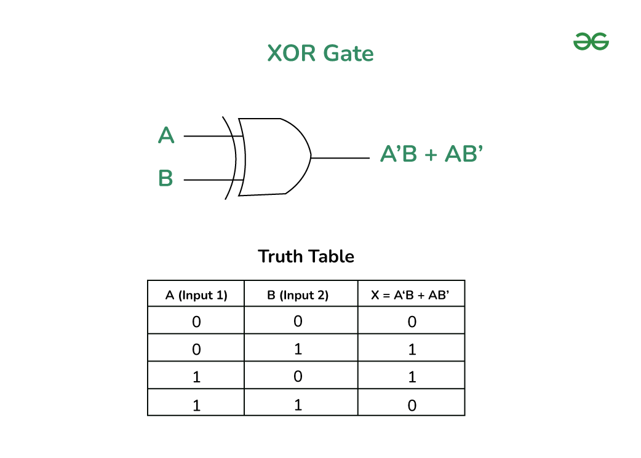
Lecture
SLIDE 8 / 10
Overflow Detection in Arithmetic
1
Overflow occurs when the result of an operation exceeds the representable range of bits.
2
For signed numbers, overflow happens if adding two positives yields a negative result.
3
Overflow also occurs if adding two negatives yields a positive result in signed arithmetic.
4
The overflow flag is set by XORing the carry-in and carry-out of the MSB.
5
Unsigned overflow is simply detected by the final carry-out of the most significant bit.
6
Detecting overflow is crucial for ensuring the correctness of arithmetic operations in software.
Source: media.geeksforgeeks.org
Chandigarh University
8 / 10
Notes:
Overflow is a critical concept. If we add two large positive numbers and get a negative result, we have overflowed. This happens when the carry into the sign bit differs from the carry out. We detect this by XORing the carry-in and carry-out of the most significant bit. This flag alerts the processor that the result is invalid.

Slide 9

Lecture
SLIDE 9 / 10
Key Takeaways
1
Full adders are the fundamental building blocks for multi-bit binary addition circuits.
2
Ripple carry adders chain full adders but suffer from propagation delay for large n.
3
Subtraction is efficiently implemented by adding the two's complement of the subtrahend.
4
Overflow detection relies on comparing the carry-in and carry-out of the MSB.
5
Unified adder-subtractor circuits use control signals to switch between operations seamlessly.
Source: slidemodel.com
Chandigarh University
9 / 10
Notes:
To summarize, we use full adders to build ripple carry adders for addition. Subtraction is handled by converting it to addition using two's complement. We must always check for overflow to ensure data integrity. These concepts form the basis of all arithmetic logic units in computer systems.

Slide 10
Lecture
SLIDE 10 / 10
References
COMPUTER ORGANIZATION AND DESIGN
The Hardware/Software Interface — David A. Patterson, John L. Hennessy
COMPUTER ARCHITECTURE
A Quantitative Approach — John L. Hennessy, David A. Patterson
• Computer Organization and Architecture — William Stallings
• Computer System Architecture — M. Morris Mano & Rajib Mall
• Computer Organization — Carl Hamacher, Zvonko Vranesic, Safwat Zaky
Chandigarh University
10 / 10
Notes:
These textbooks provide the theoretical foundation and detailed circuit designs discussed today. I encourage you to read the chapters on arithmetic units in Stallings and Mano for deeper insights. These resources will help you design more advanced arithmetic circuits in your future projects. Thank you for your attention.

